Slide 1




Presentation on
ONLINE BANKING AND CYBER SECURITY CONCERNS

Slide 2

UNDERSTANDING & INTRODUCTION TO ONLINE BANKING
History of Online Banking
Online banking dates back to the 1980s with the introduction of telebanking and ATMs.
Types of Online Accounts
Online banking accounts can include checking, savings, mortgages, and investment accounts.
Advantages of Online Banking
Convenience, accessibility, and real-time transaction monitoring are key benefits of online banking.
Convenience of Access
Online banking offers 24/7 access to account information and transaction capabilities.
Digital Transactions
It involves carrying out bank transactions through the internet using electronic devices such as smartphones, tablets, or computers.
Virtual Banking Features
Includes features such as fund transfers, bill payments, and account management via the internet.

Slide 3



EVOLUTION OF ONLINE BANKING
Shift to Digital Platforms
Emergence of Mobile Banking
Integration of Fintech Solutions
Online banking has evolved from basic account viewing to sophisticated digital platforms offering extensive financial services.
The proliferation of smartphones led to the development of mobile banking apps, transforming the banking experience.
Online banking has embraced fintech innovations, such as AI, blockchain, and biometric authentication, for enhanced security and convenience.

Slide 4

RISKS ASSOCIATED WITH ONLINE BANKING
Data Breaches
Sensitive customer information is at risk of being compromised through data breaches, leading to financial loss and identity theft.
Phishing and Fraudulent Activities
Online banking users are susceptible to phishing scams and fraudulent activities aimed at obtaining sensitive account information.
Cyber Theft and Identity Fraud
Theft of funds and identity fraud are potential risks associated with online banking, necessitating robust security measures.
Financial Fraud
Online banking is vulnerable to financial scams such as unauthorized transactions and account takeovers.

Slide 5
UNDERSTANDING CYBER SECURITY
Cyber Threat Landscape
Data Encryption Techniques
Understanding the evolving cyber threat landscape is essential for implementing effective security strategies in online banking.
Advanced encryption techniques are crucial for securing sensitive financial data transmitted through online banking channels.
Authentication Protocols and
App permissions
Implementing robust authentication protocols helps verify the identity of users accessing online banking services.

Slide 6
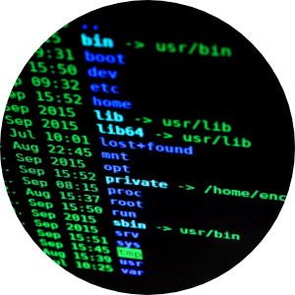
COMMON CYBER THREATS IN ONLINE BANKING
Malware Attacks
Malicious software is used to infiltrate online banking systems, leading to financial fraud and data theft.
Social Engineering Tactics
Cybercriminals employ social engineering to manipulate users into disclosing sensitive financial information.
Ransomware Incidents
Ransomware poses a significant threat to online banking systems, causing financial disruptions and data extortion.
Phishing Scams & OTP Bypass
Phishing involves fraudulent attempts to obtain sensitive information such as usernames, passwords, and credit card details.

Slide 7
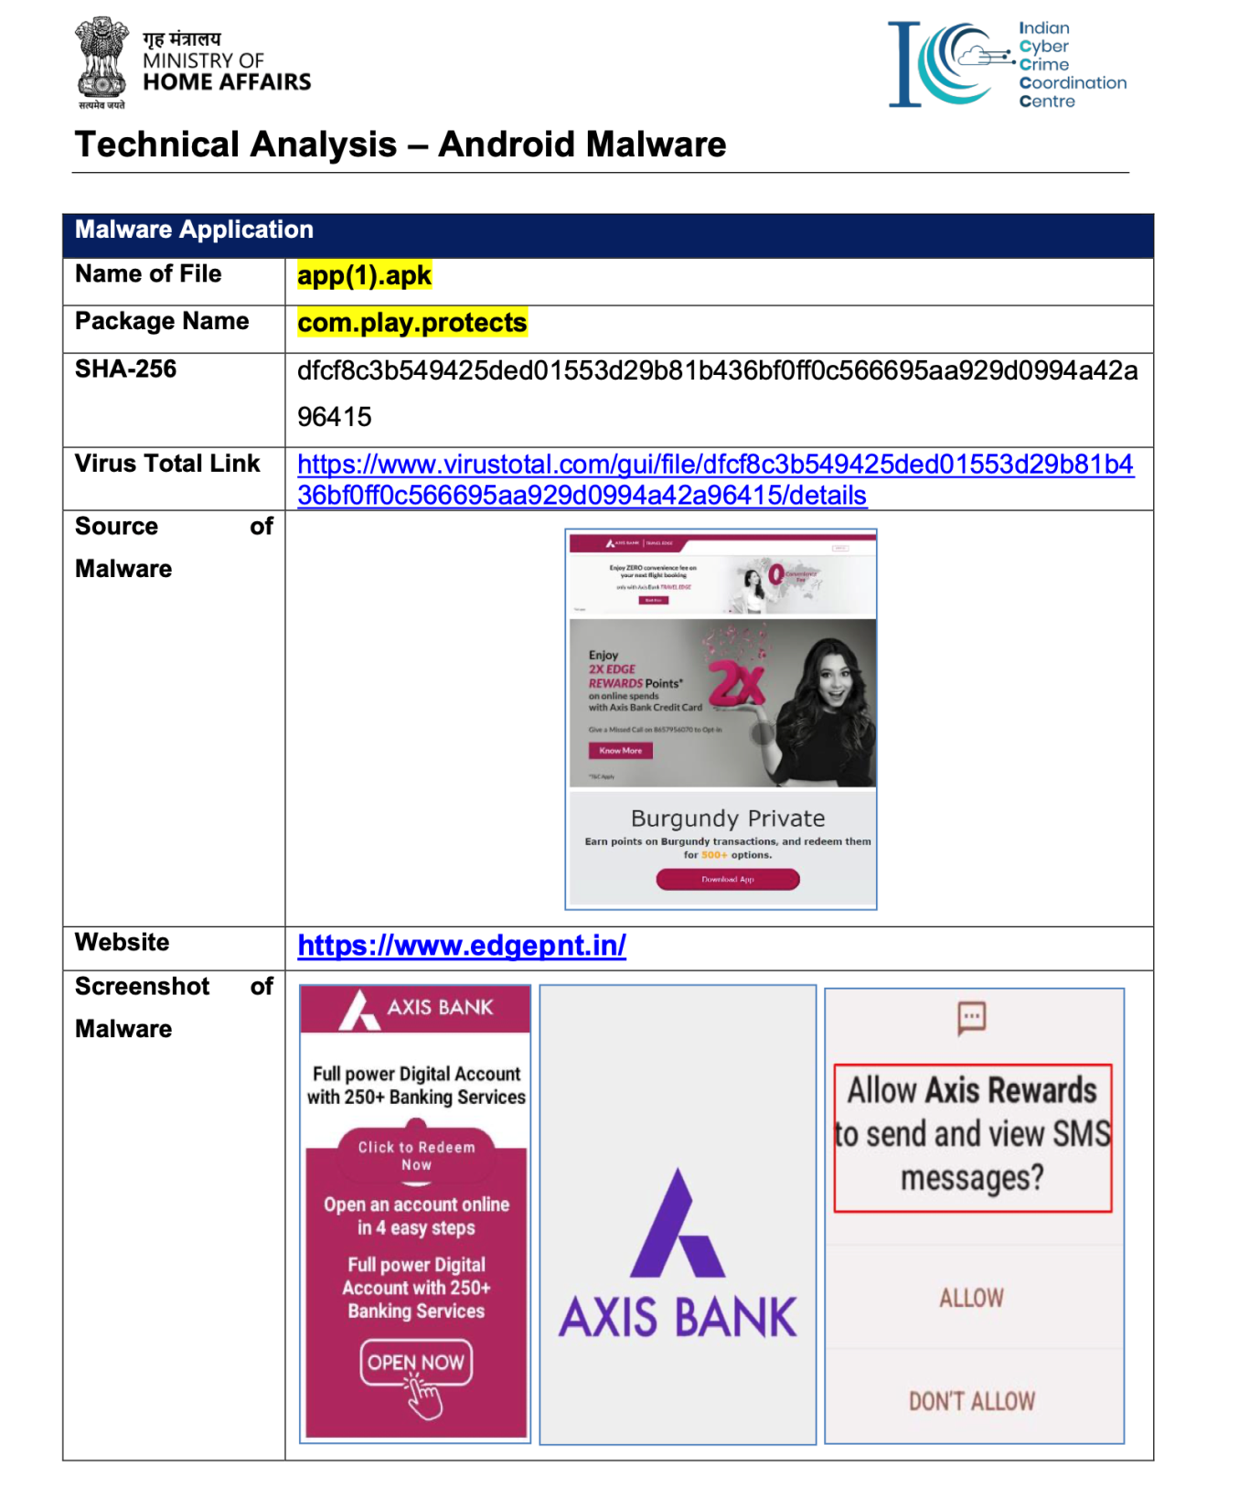
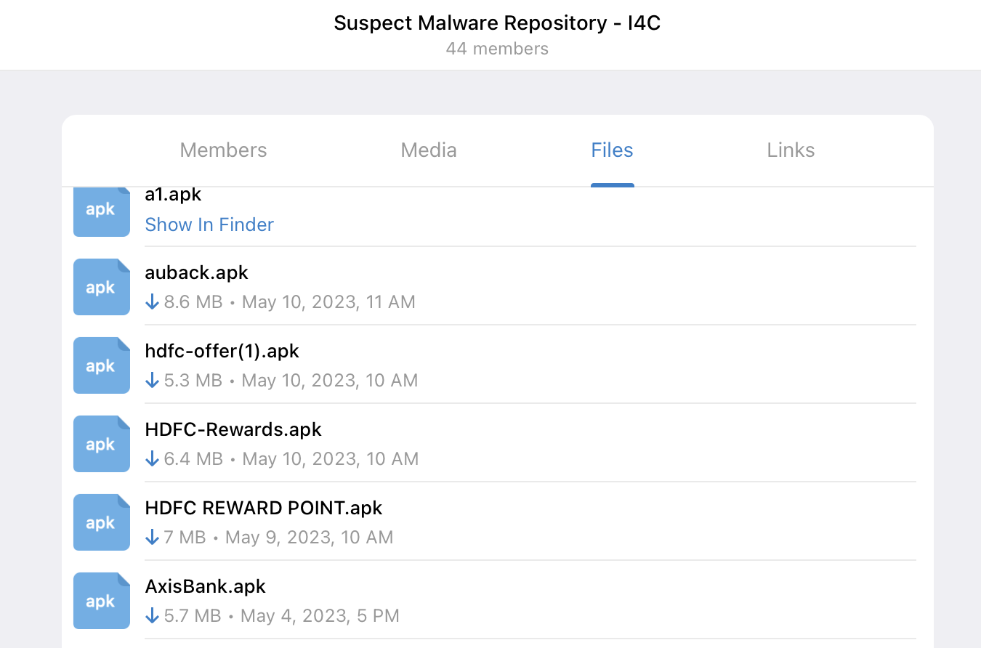
BANKING MALWARES
Fin-CERT, Banks, LEAs, Regulators

Slide 8

PHISHING AND SOCIAL ENGINEERING
Fraudulent Schemes
Understanding and identifying deceptive tactics used in phishing and social engineering schemes to deceive online banking users.
Psychological Manipulation
Exploring the psychological tactics employed by cybercriminals to manipulate individuals into divulging confidential information.
Email and Communication Risks
Recognizing the risks associated with fraudulent emails and deceptive communications designed to exploit online banking users.

Slide 9
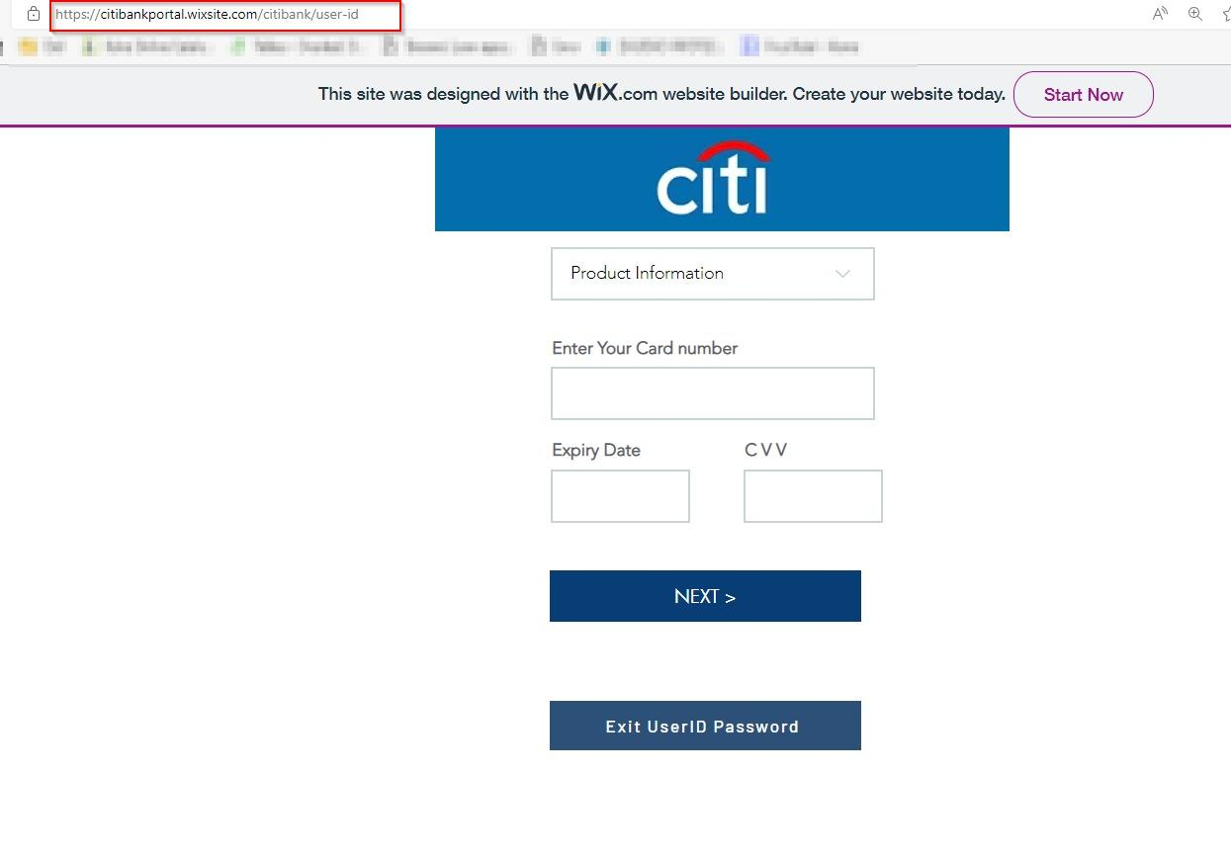
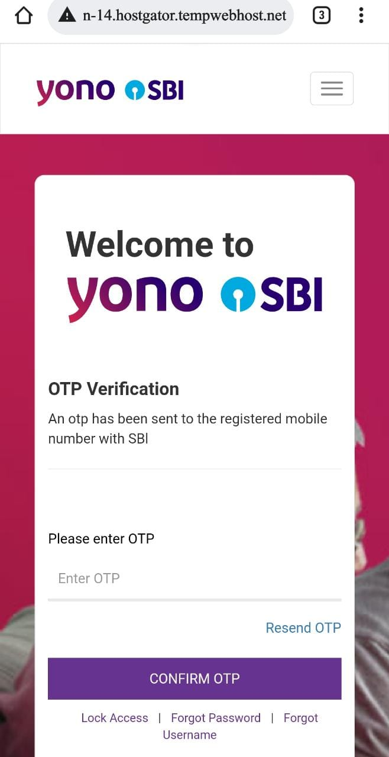
CREDENTIAL HARVESTING WITH PHISHING – HOW DOES IT WORK?

Slide 10
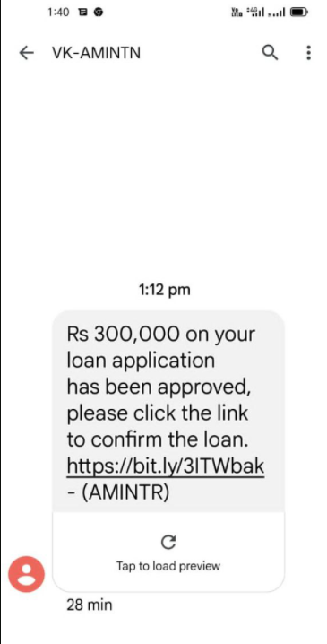
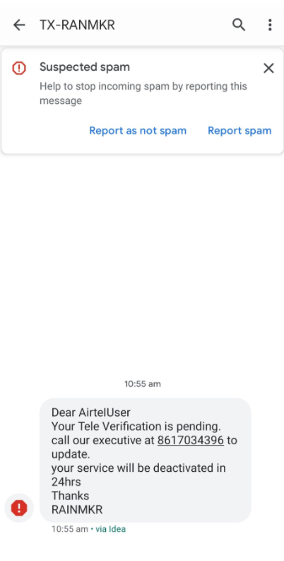
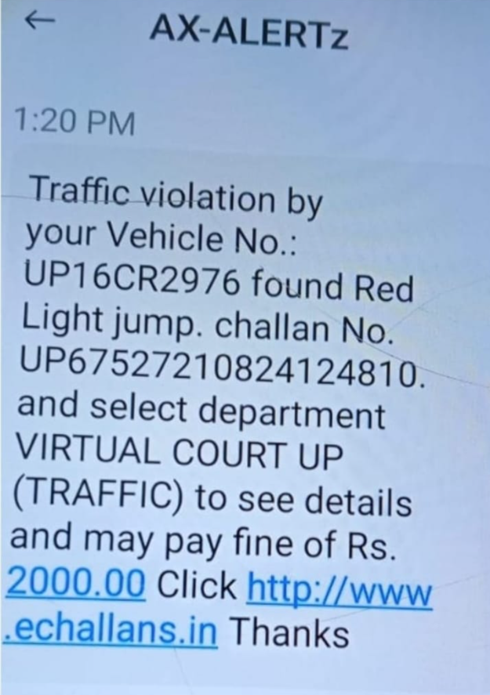
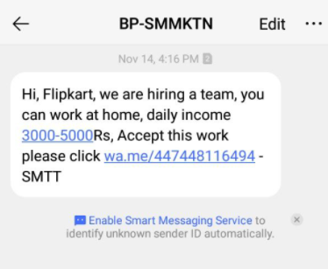

SOCIAL ENGINEERING: LOVE, GREED, FEAR
Loan SMS - Harassment

Slide 11
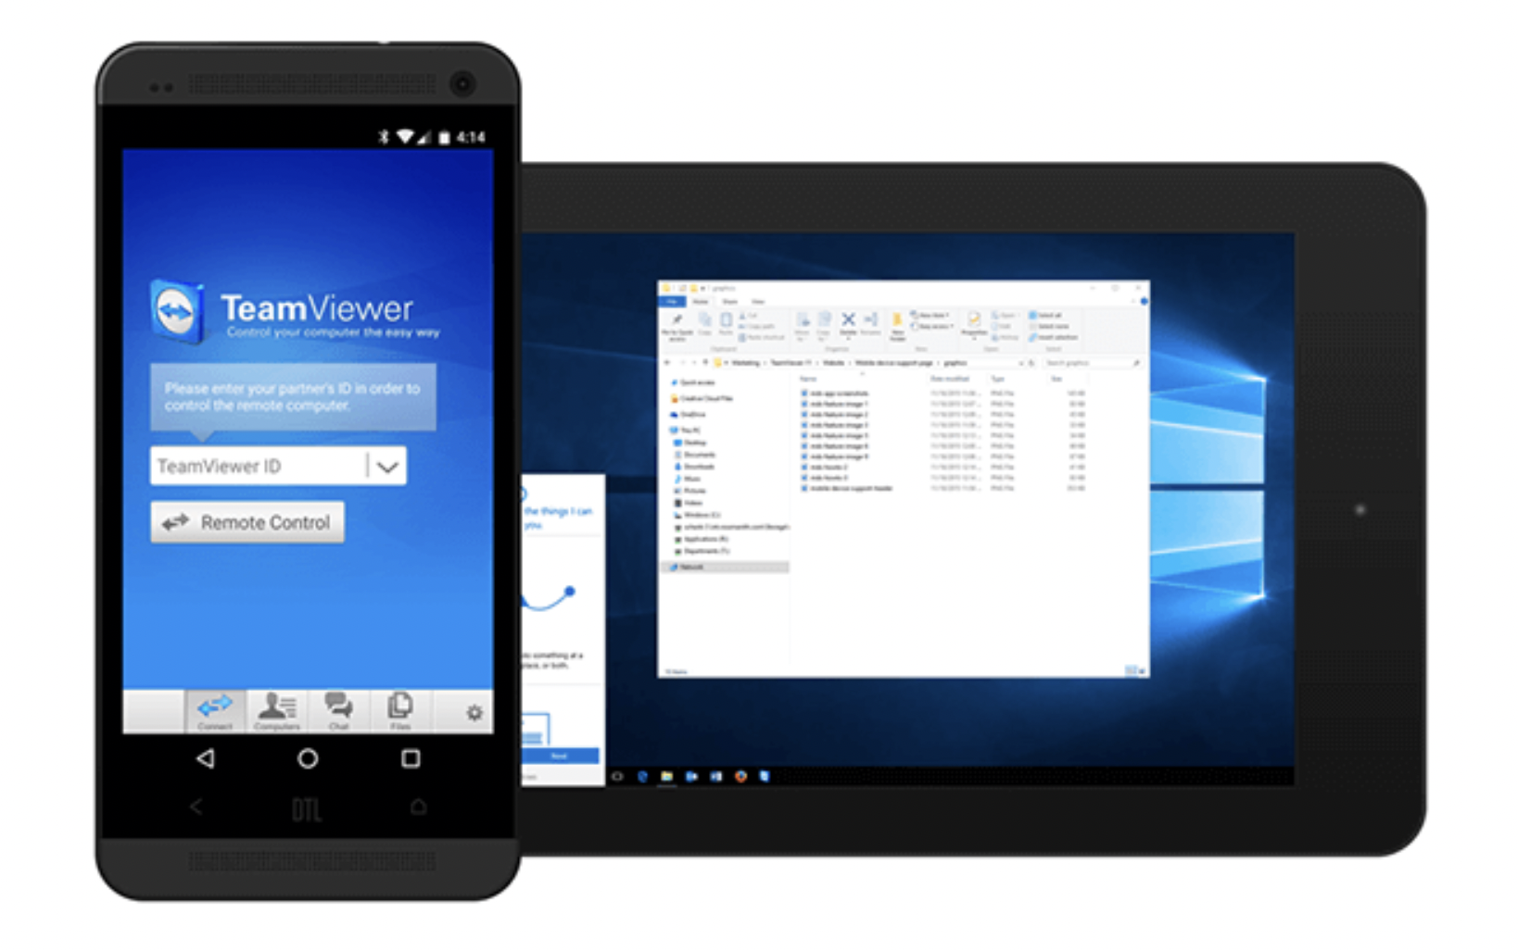
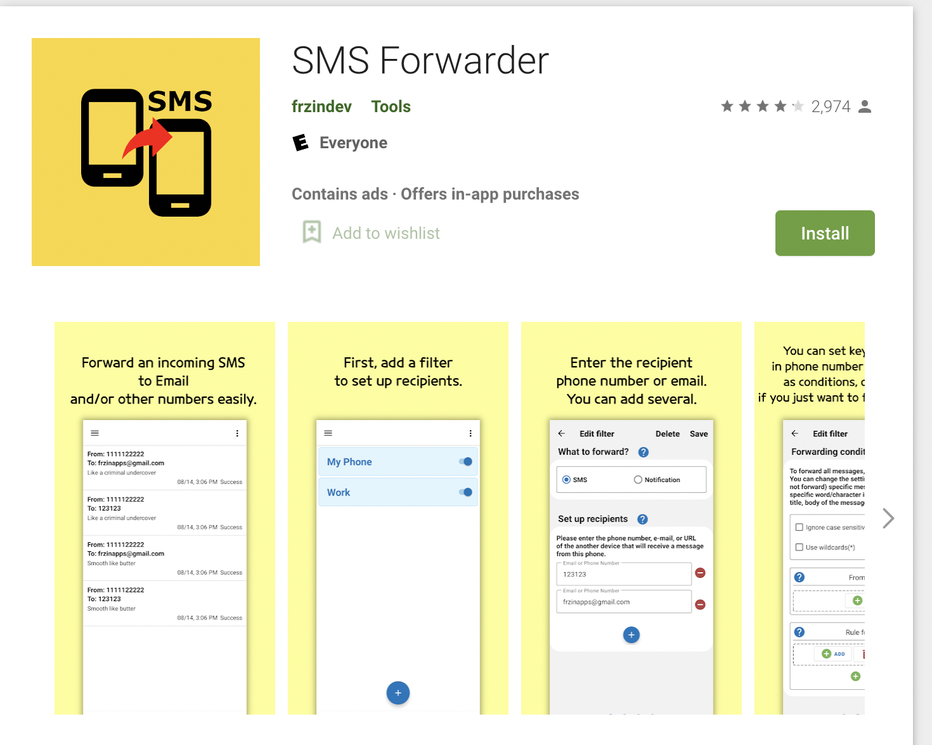
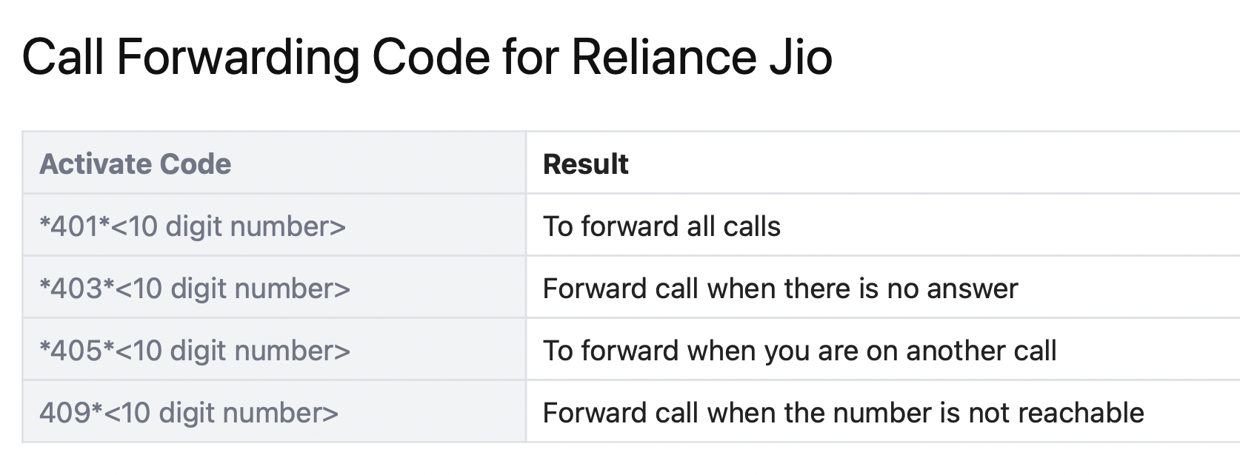
OTP BYPASS
2
Remote Control
Mobile Application
1
4
Phishing – Real Time OTP
3
Call based OTP Theft
5
OTP over email
6
Mobile Number Update
7
Call Conference Based

Slide 12

SECURITY MEASURES IN ONLINE BANKING
Biometric Authentication
Biometric verification methods, such as fingerprint and facial recognition, bolster the security of online banking transactions.
Multi-factor Security
Employing multiple authentication factors, such as passwords and OTPs, enhances the security of online banking systems.
Secure Server Infrastructure
Robust server infrastructure with encryption and firewalls forms the foundation for secure online banking operations.
Encryption Protocols
Utilizing secure encryption protocols to protect sensitive data during online transactions and communications.
Firewall Protection
Implementing firewalls to prevent unauthorized access and intrusions into the online banking system.
Regular Security Updates
Frequent updates to security systems and software to address vulnerabilities and strengthen defenses against cyber threats.

Slide 13

MULTI-FACTOR AUTHENTICATION
Role in Enhancing Security
Implementing additional layers of identity verification to prevent unauthorized access and account breaches.
Types of Authentication Factors
Factors include knowledge (passwords), possession (phones), and inherence (biometrics), reinforcing online banking security.
Integration in Online Banking
Integration of two-factor authentication is essential for mitigating unauthorized access and enhancing the security of online banking platforms.

Slide 14

ROLE OF ENCRYPTION IN ONLINE BANKING
Encryption Mechanisms
Utilizing strong cryptographic algorithms ensures the confidentiality and integrity of sensitive financial data in online banking.
Secure Data Transmission
Encryption facilitates secure transmission of financial information over digital channels, safeguarding it from unauthorized interception.
Importance of SSL Certificates
SSL certificates are vital for establishing a secure connection between users' browsers and online banking servers, preventing data breaches.
Cryptographic Algorithms
Implementing robust cryptographic algorithms to secure data and communications in online banking systems.
Protection against Unauthorized Access
Encryption serves as a barrier against unauthorized access, ensuring that only authorized parties can interpret the data.

Slide 15

BEST PRACTICES FOR SAFE ONLINE BANKING
Secure Password Management
Adopting strong, unique passwords and regularly updating them is critical for safeguarding online banking accounts.
Regular Account Monitoring
Frequent monitoring of account activities helps detect and prevent unauthorized transactions or suspicious behavior.
Software and Security Updates
Regularly updating software and security applications mitigates vulnerabilities and strengthens online banking security.
Security Awareness Education
Educating online banking users about cybersecurity best practices and potential risks to foster a security-conscious mindset.

Slide 16

REGULATIONS AND COMPLIANCE IN ONLINE BANKING
Compliance Requirements
Online banking institutions must adhere to regulatory requirements to ensure the security and integrity of financial transactions.
Anti-Money Laundering (AML)
Implementing AML practices mitigates the risk of illegal financial transactions and enhances the security of online banking systems.
Data Privacy Regulations
Adhering to data privacy laws safeguards customers' personal and financial information, promoting trust in online banking services.

Slide 17
CASE STUDIES OF CYBER SECURITY BREACHES
Impact on Financial Institutions
Cybersecurity breaches have significant repercussions, including financial losses, reputational damage, and customer distrust.
Lessons Learned
Analyzing cyber breach case studies enables institutions to identify vulnerabilities and strengthen their online banking security measures.
Addressing Customer Concerns
Effectively addressing customer concerns following security breaches is key to rebuilding trust and maintaining clientele.

Slide 18
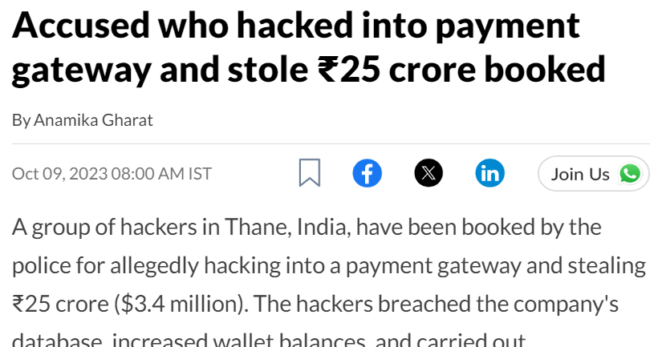
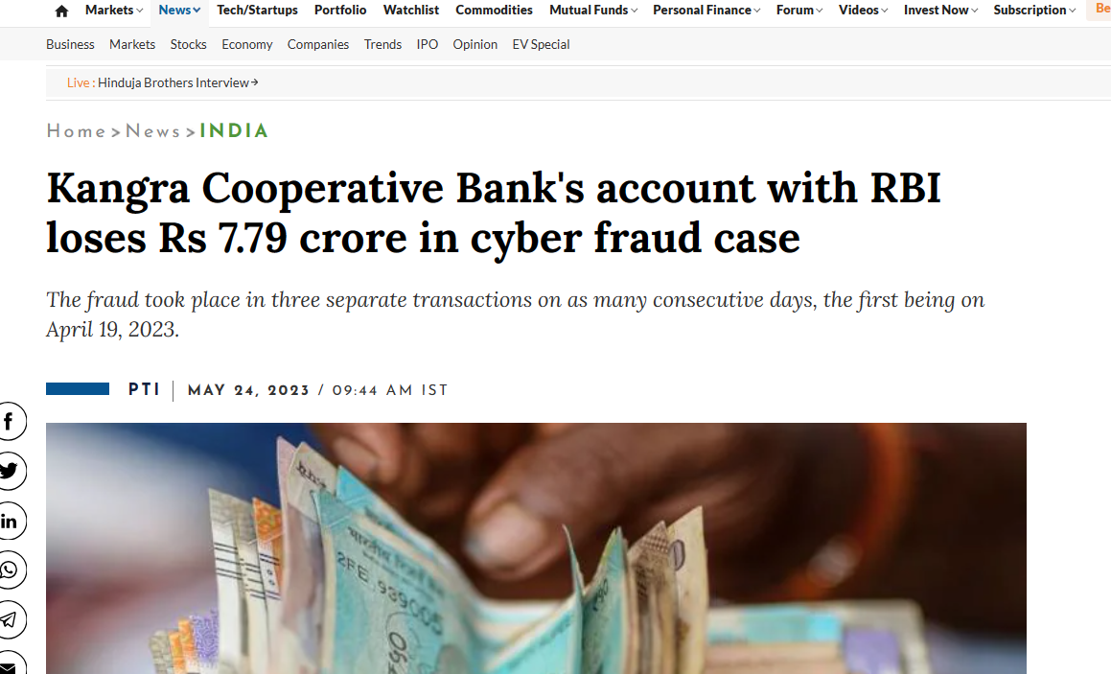
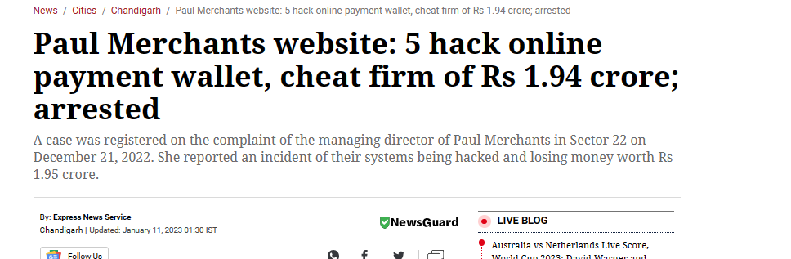
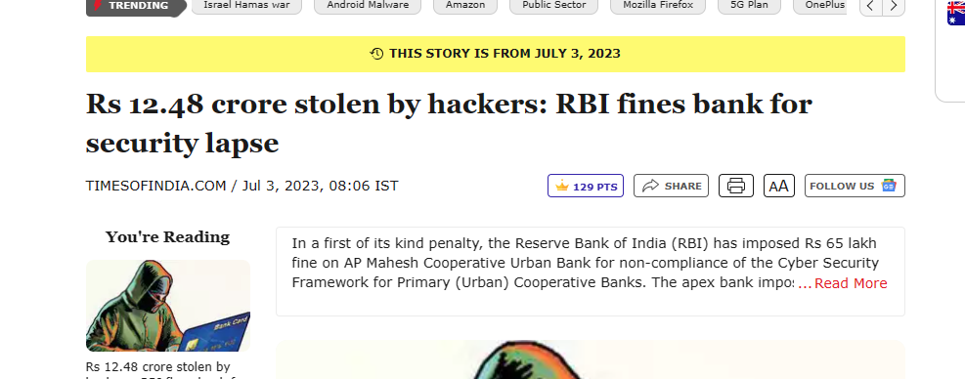

Slide 19

FUTURE TRENDS IN ONLINE BANKING SECURITY
Adoption of Biometric Technologies
Blockchain for Secure Transactions
Increased use of biometric authentication and identification will redefine the security landscape for online banking.
Leveraging blockchain technology will enhance the transparency, security, and immutability of online banking transactions.
Role of AI in Cybersecurity
AI applications will play a pivotal role in predicting and preventing cyber threats, augmenting online banking security measures.

Slide 20

CONCLUSION
Risk Mitigation Strategies
Constant Vigilance
Implementing robust security measures and compliance with regulations is imperative for mitigating online banking risks.
Continuous monitoring and proactive adoption of security technologies are essential to safeguard the integrity of online banking.
Customer Education and Trust
Educating customers about online security best practices and building trust are fundamental for sustainable online banking operations.
Continuous Adaptation
Recognizing the need for ongoing adaptation and improvement of security measures to address evolving cyber threats in online banking.

Slide 21
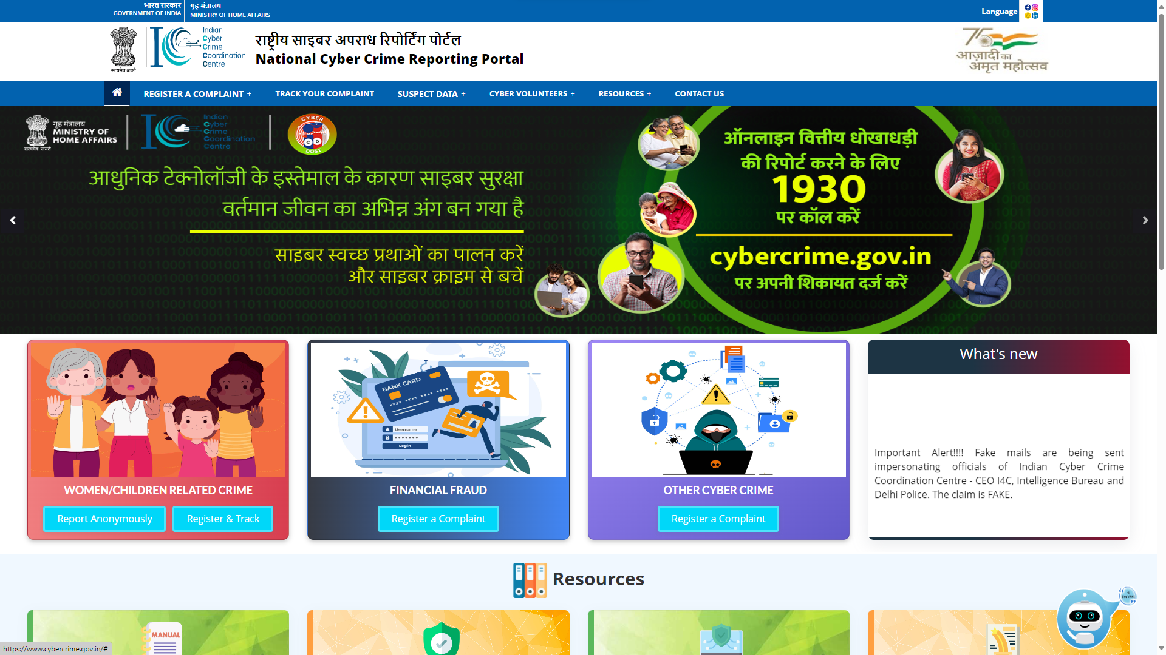

Slide 22
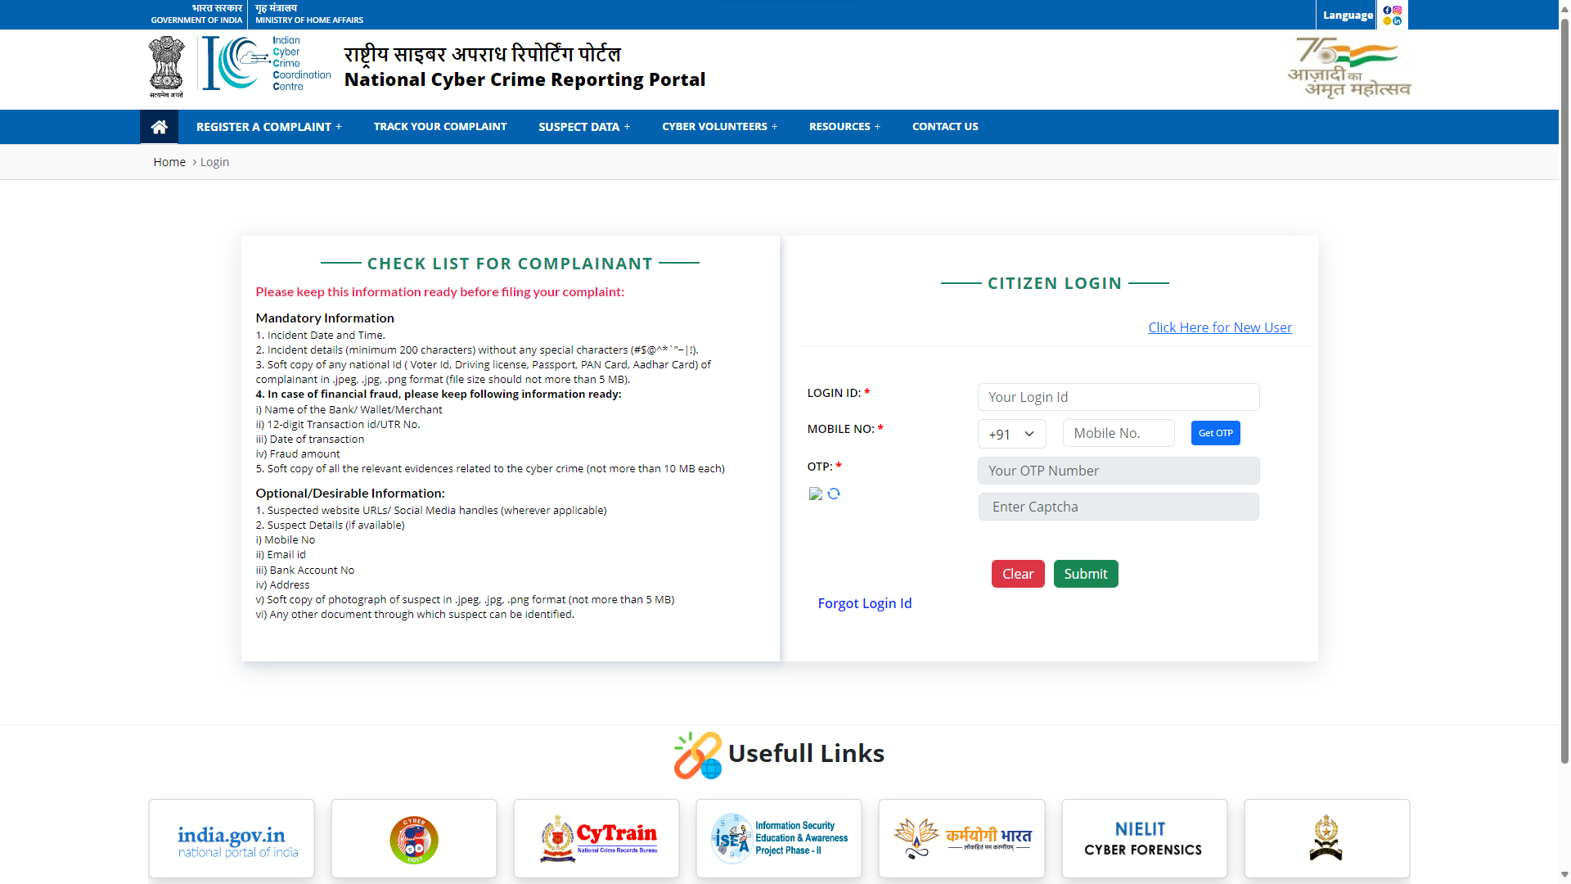

Slide 23

Thank You

